Slide 1


TMN2223 Object oriented software development Project: Online Hospital Blood Test Appointment
Member | Matric No
Holifield William (L.G01) | 69861
Muhd Hamarudin bin Omar Ali (L.G01) | 70653
Ting Lee Ji (L.G01) | 72713
Mohd Zaki bin Ahmad Mustafa (L.G01) | 72368
Siti Hamizah binti Zainul Abidin (L.G01) | 72676
Christopher Sii How Chiong (L.G01) | 69385
Instructor: Dr Chai Soo See

Slide 2
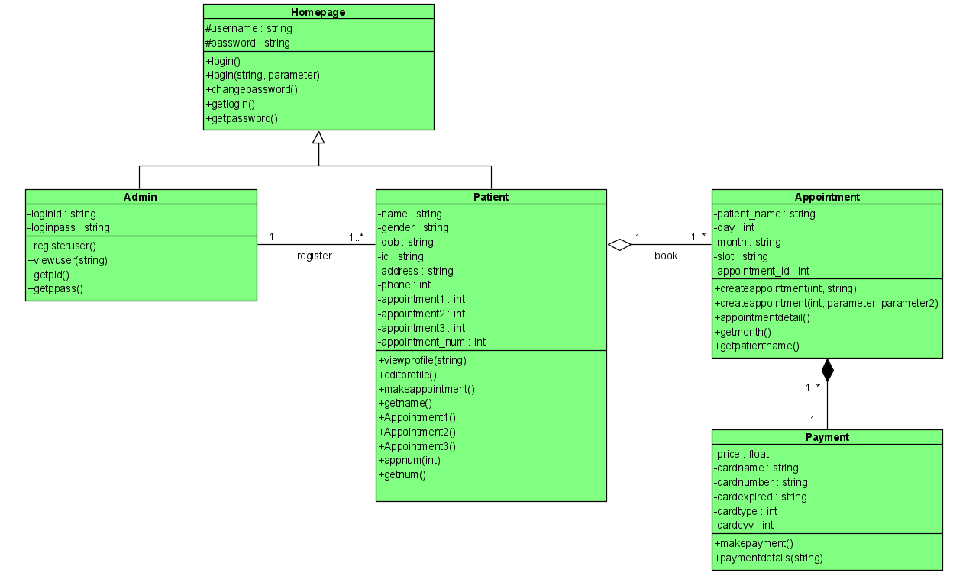
Class diagram

Slide 3
test case: admin
Test case 1 | Log in (positive)
Input value | Username: admin Password: admin12#
Action | Select admin option Key in the log in ID and password
Expected output | Log in successful Main page of Admin appears
Test case 2 | Log in (negative)
Input value | Username: admin Password: 12#
Action | Select admin option Key in the log in ID and password
Expected output | Log in fail Error page wrong admin login info appears
Test case 3 | Manually Add user
Input value | User email: chris@gmail.com Password: 12345678Abc!
Action | Select admin option Log in with correct admin username and password Select Register new user option Key in user email Set the password Press Enter
Expected output | Registration success. An email has sent to chris@gmail.com
Test case 4 | View user list
Input value | Enter selection: User list
Action | Log in with correct admin username and password Select User list Press Enter
Expected output | List of registered user: chris@gmail.com
Test case 5 | View all appointment
Input value | Enter selection: View all appointment
Action | Log in with correct admin username and password Select View all appointment Press Enter
Expected output | List of all appointments appear

Slide 4
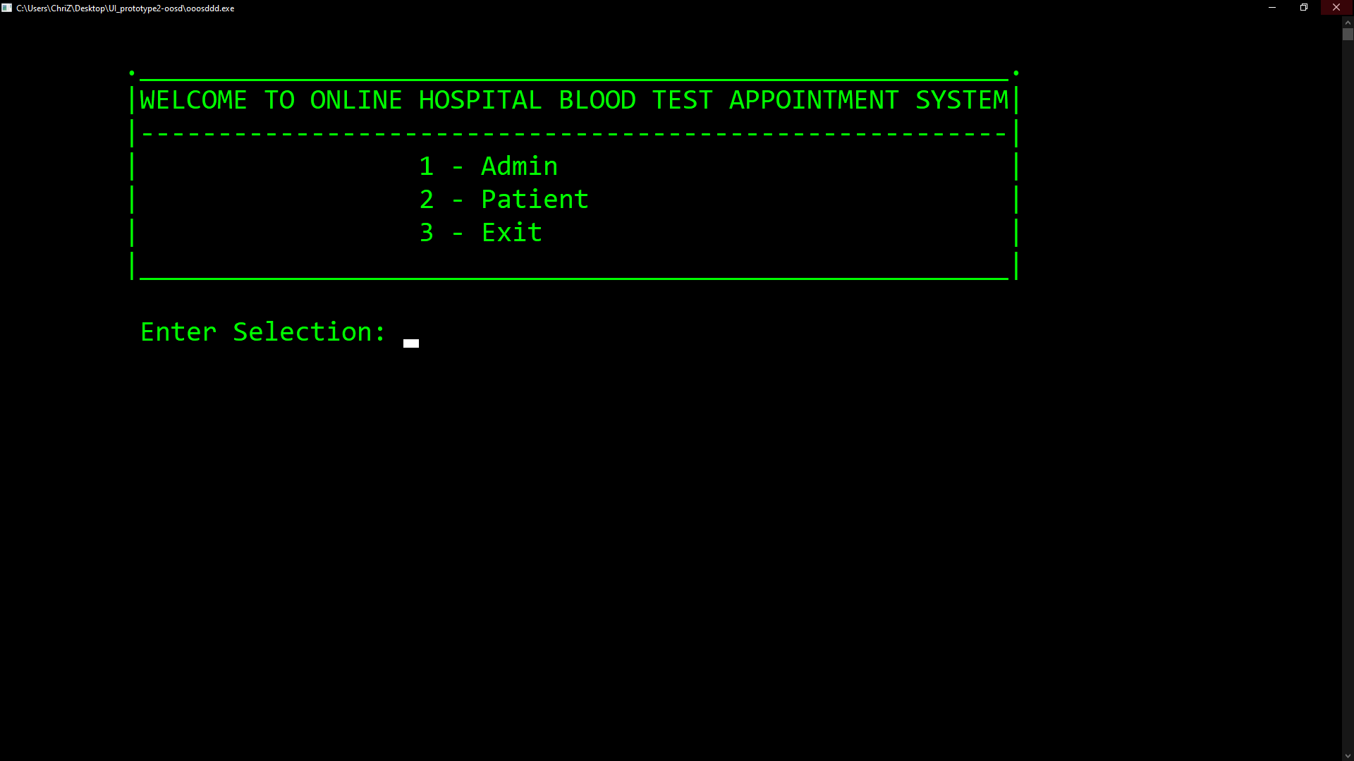
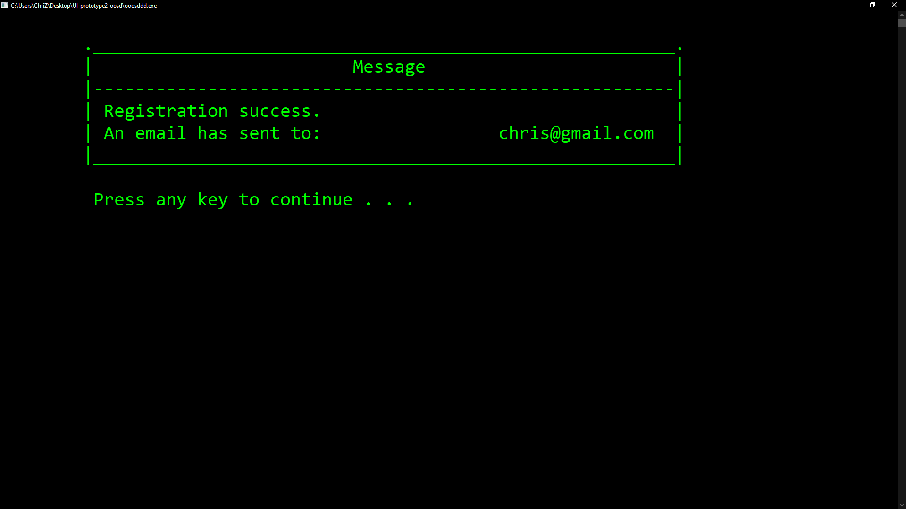
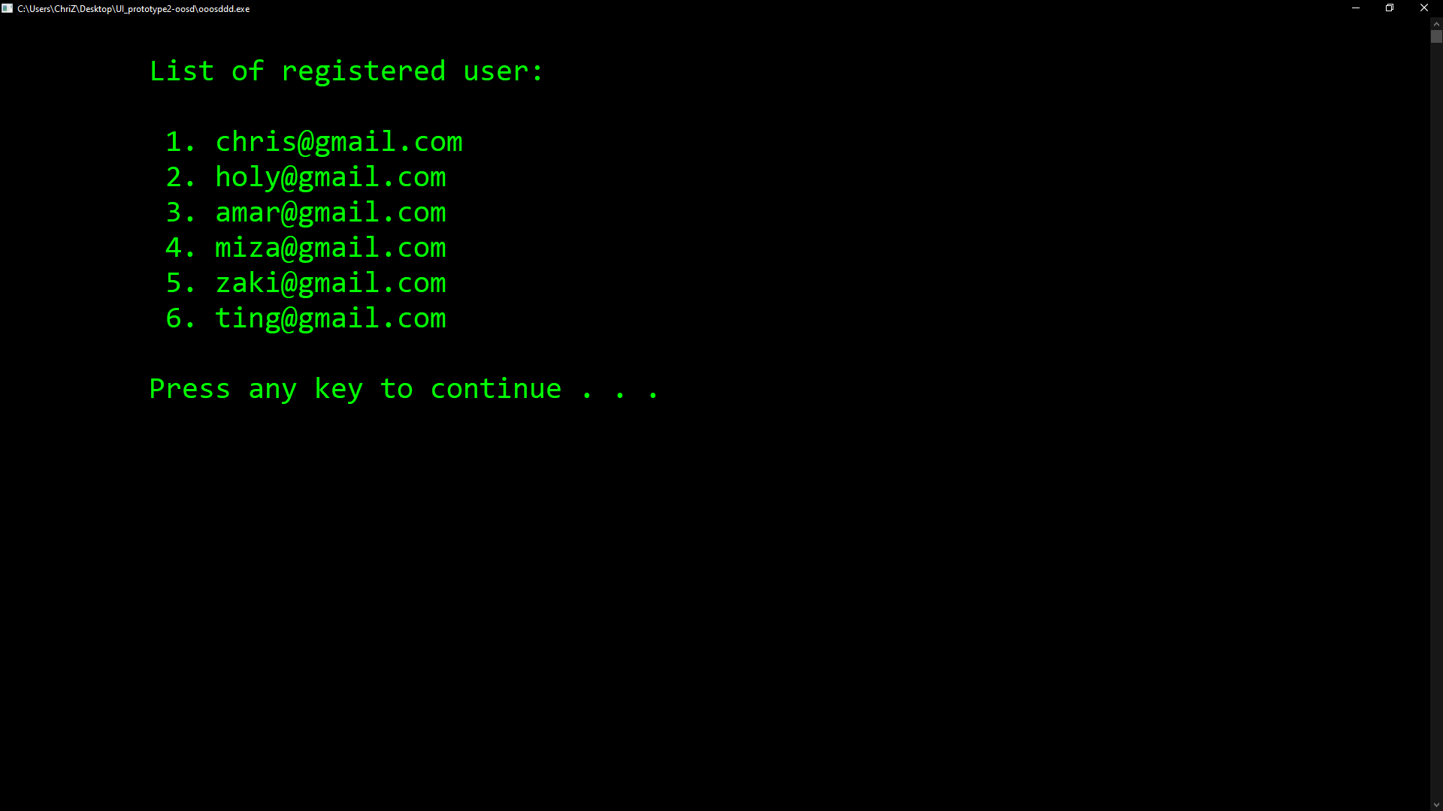
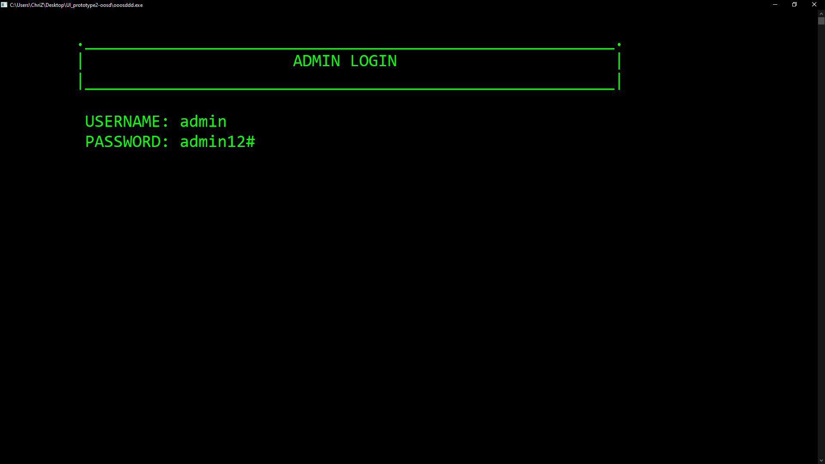
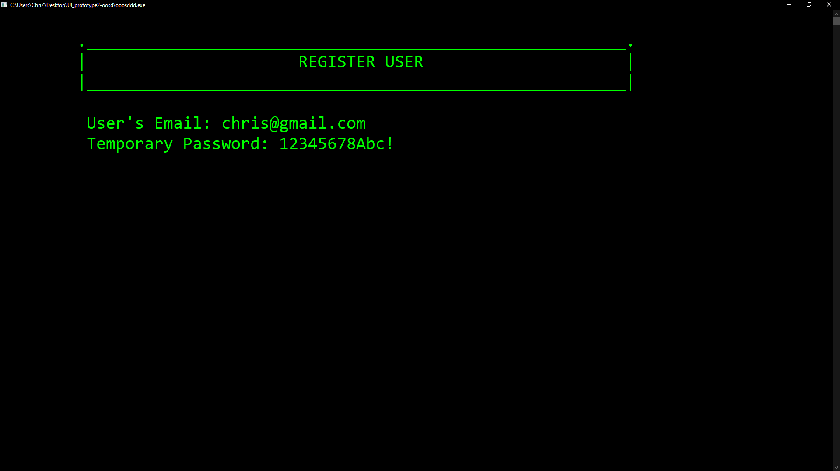
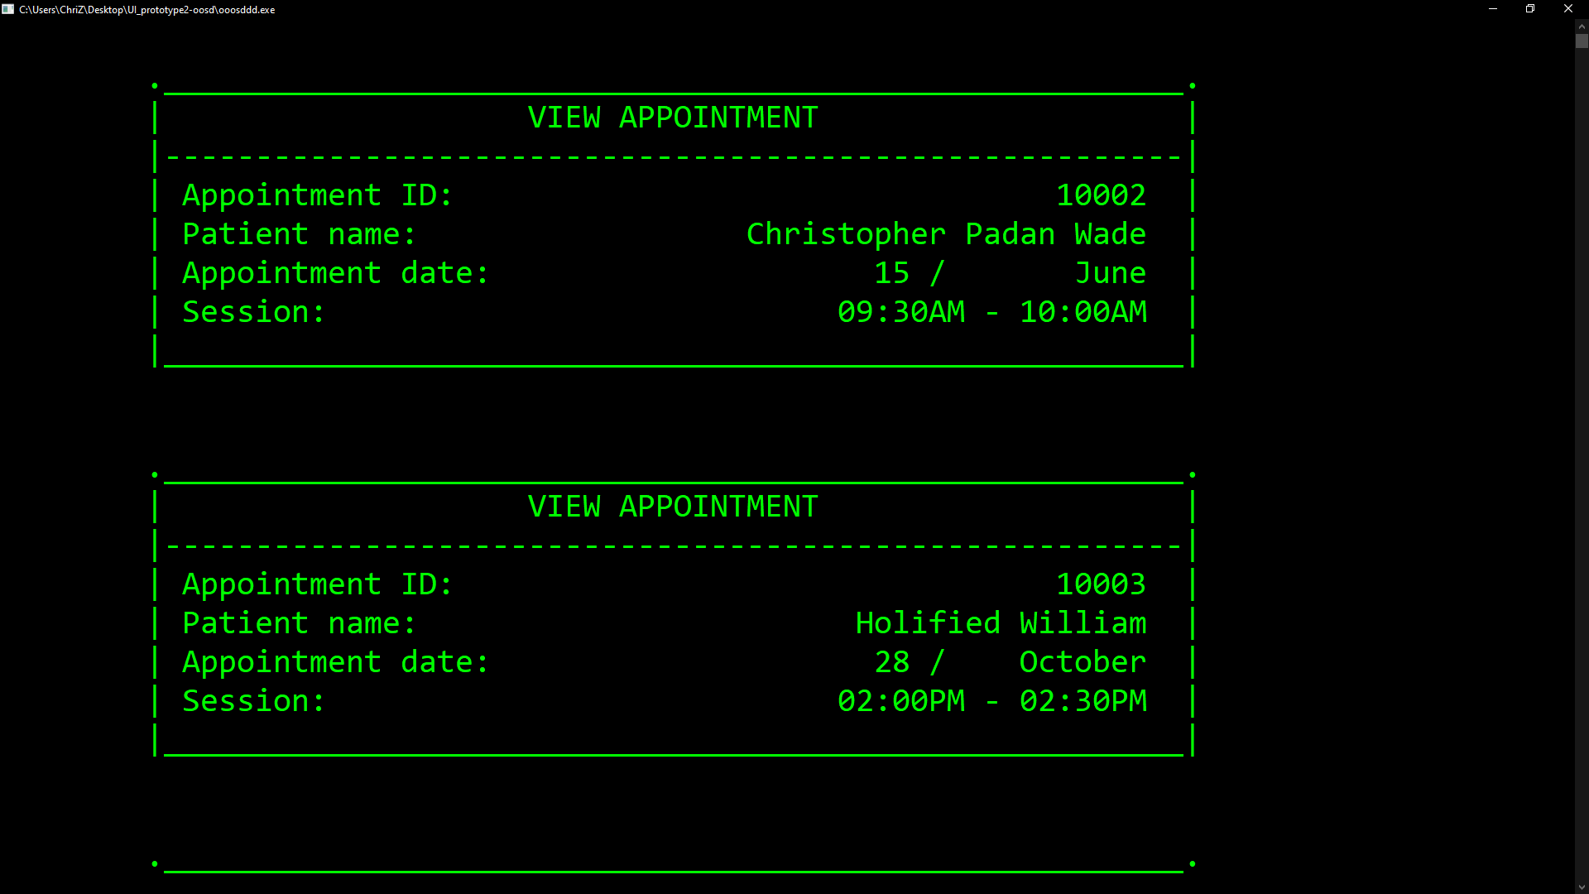
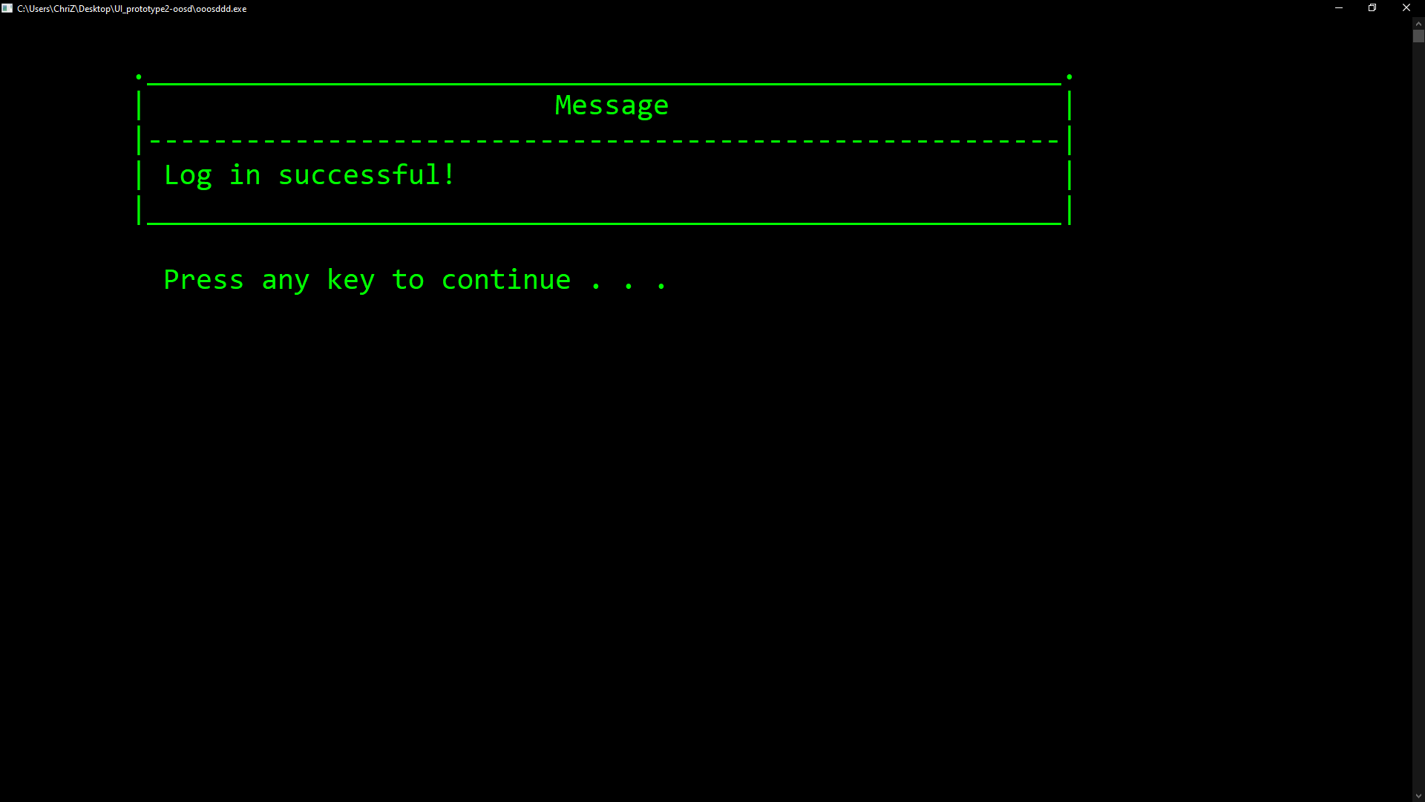
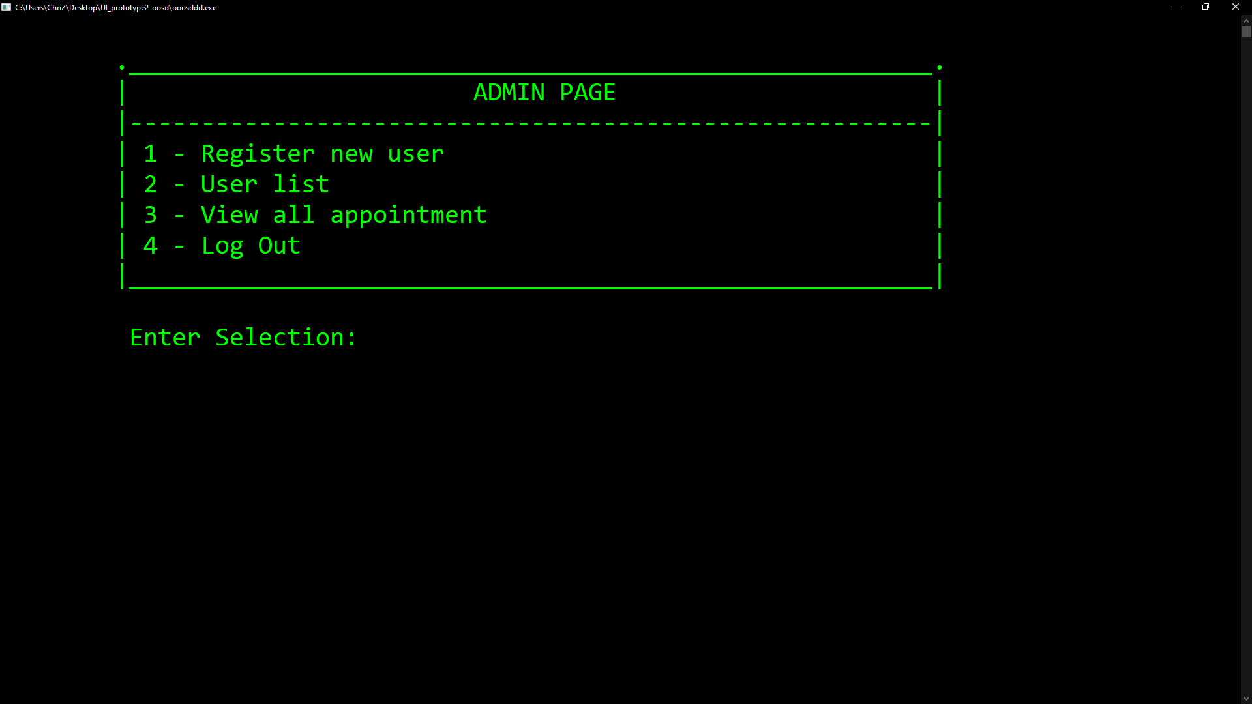
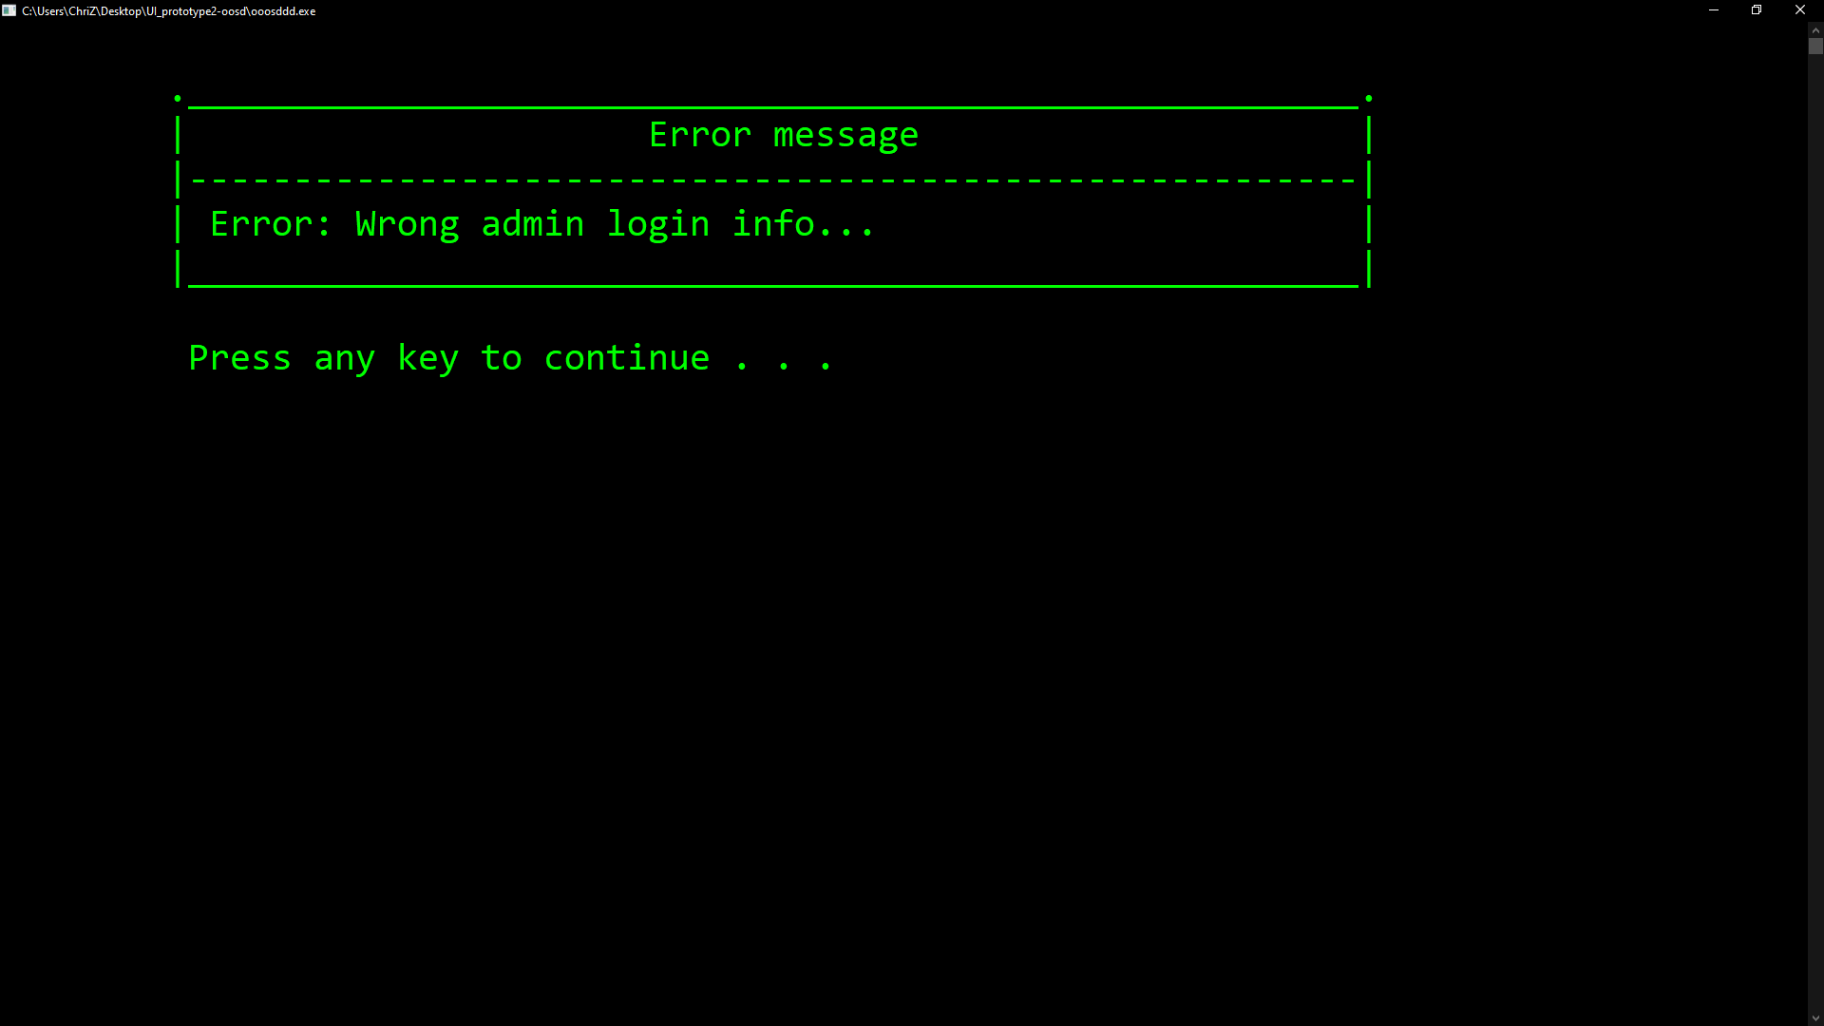
Admin

Slide 5
test case: Patient
Test case 6 | Patient login (positive)
Input value | Username: chris@gmail.com Password: 12345678Abc!
Action | Select Patient option Key in the patient username and password
Expected output | Log in successful Main page of Patient appears
Test case 7 | Patient login (negative)
Input value | Username: chris@gmail.com Password: 12345678Abd!
Action | Select Patient option Key in the patient username and password
Expected output | Log in fail error page wrong login info appears
Test case 8 | Edit patient profile details
Input value | Name: Christopher D Wade Gender (1-Male/2-Female): 1 Date of Birth (DD/MM/YY): 3/8/99 IC Number (XXXXXX-XX-XXXX): 990803-13-3399 Phone Number: +6012345678 Address: Lot 8, Jln OK, Kuching, Sarawak
Action | Select Patient option Log in with correct patient username and password Select Edit Profile
Expected output | Your profile has been saved successfully
Test case 9 | View patient profile details
Input value | Enter selection: View Profile
Action | Select Patient option Log in with correct patient username and password Select View Profile
Expected output | Name: Christopher D Wade Gender (1-Male/2-Female): 1 Date of Birth (DD/MM/YY): 3/8/99 IC Number (XXXXXX-XX-XXXX): 990803-13-3399 Phone Number: +6012345678 Address: Lot 8, Jln OK, Kuching, Sarawak

Slide 6
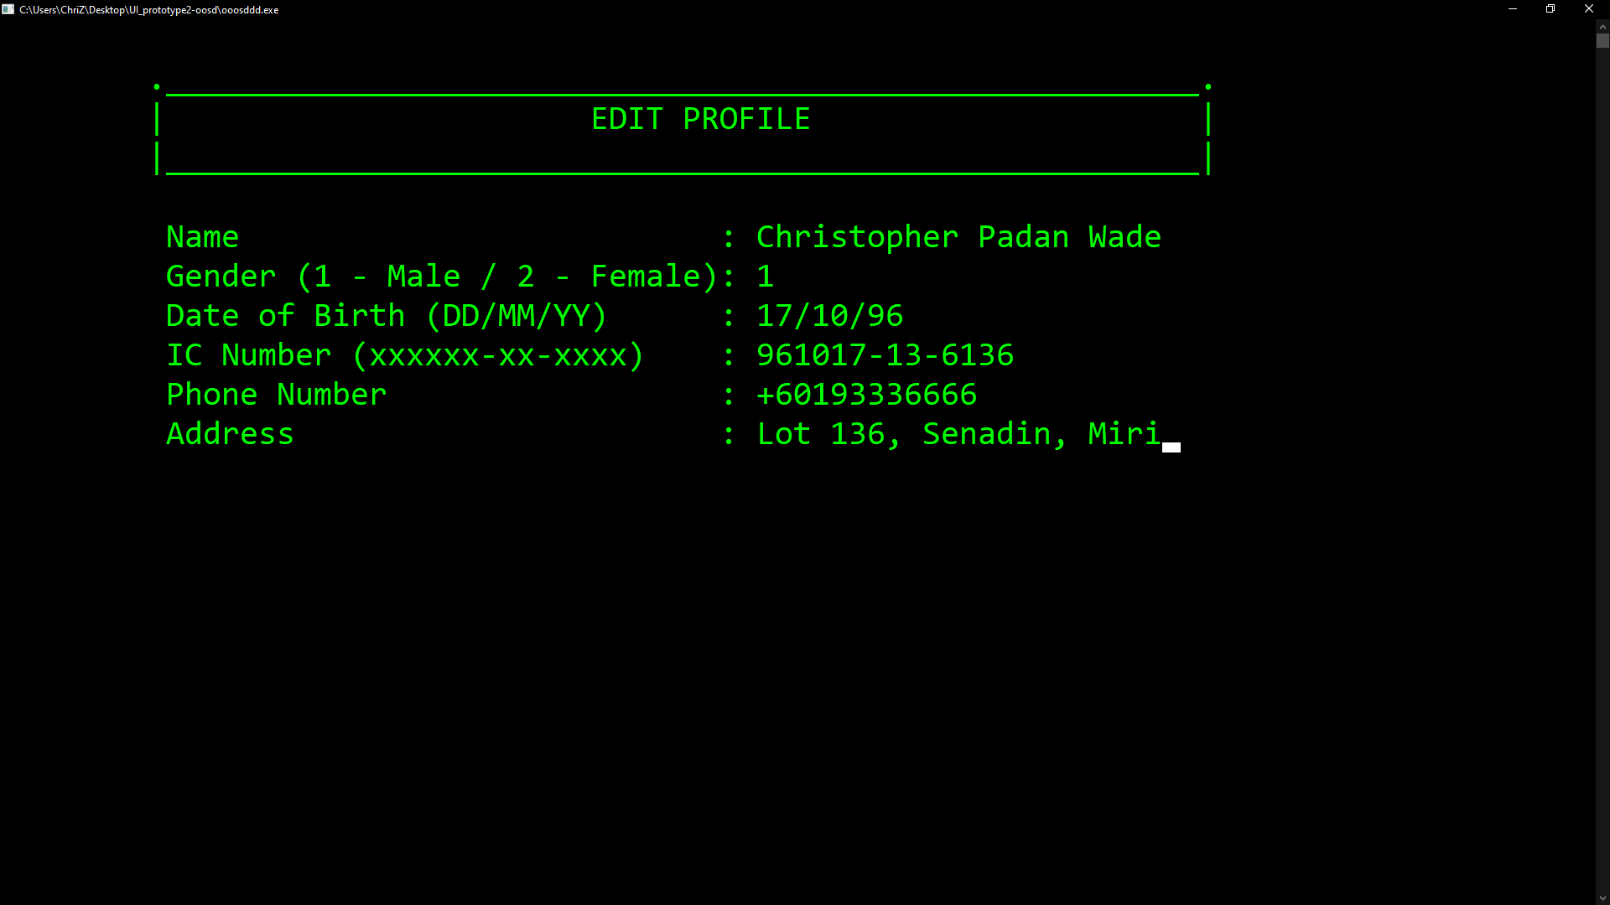
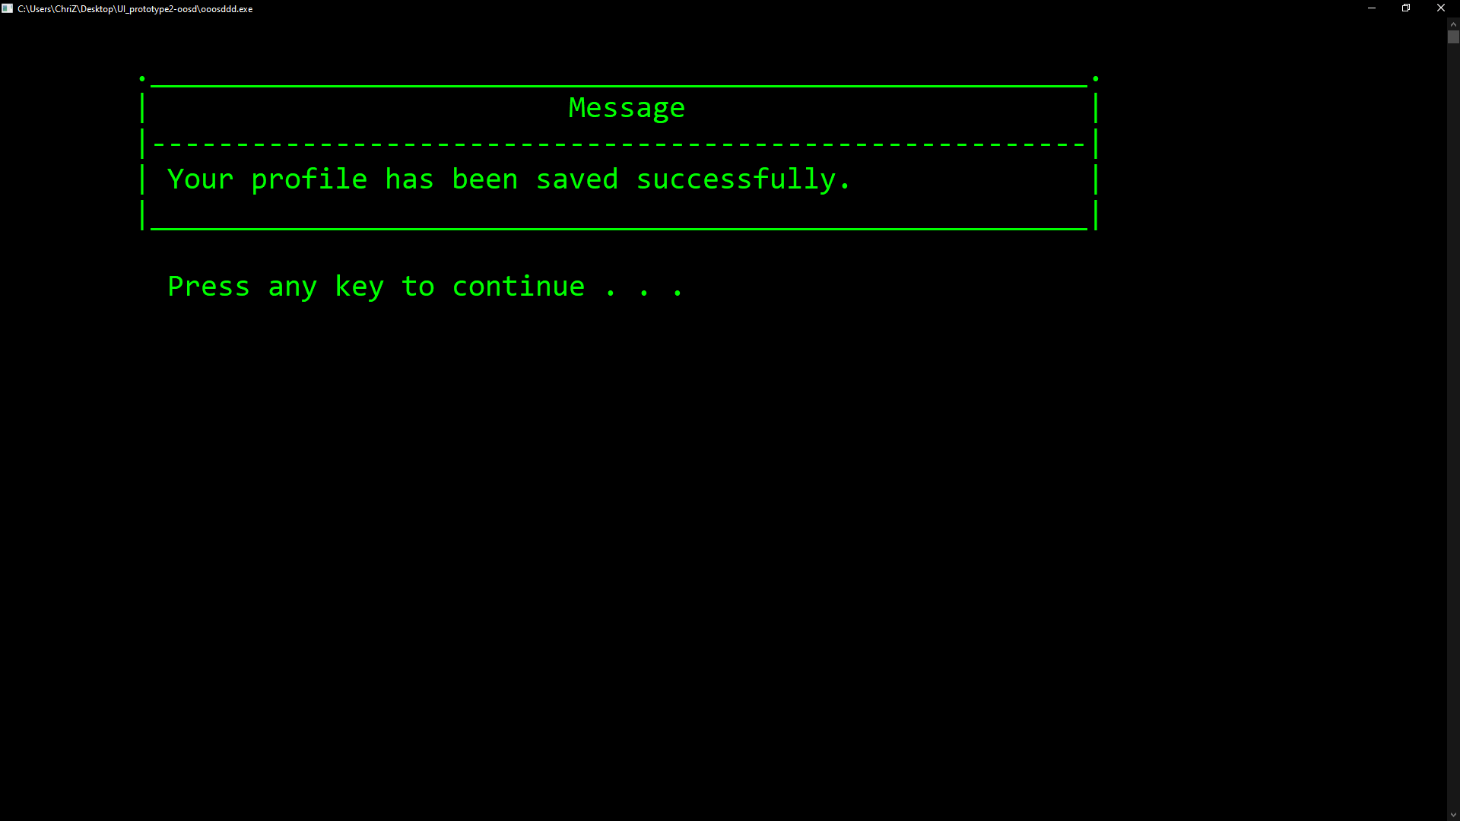
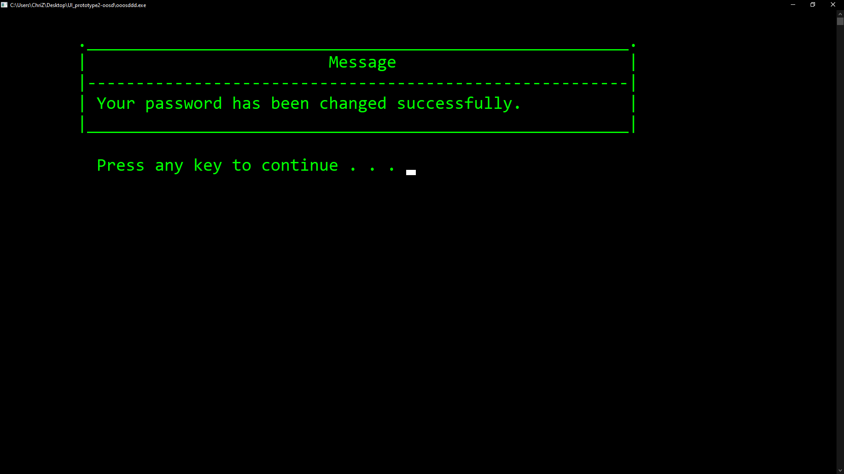
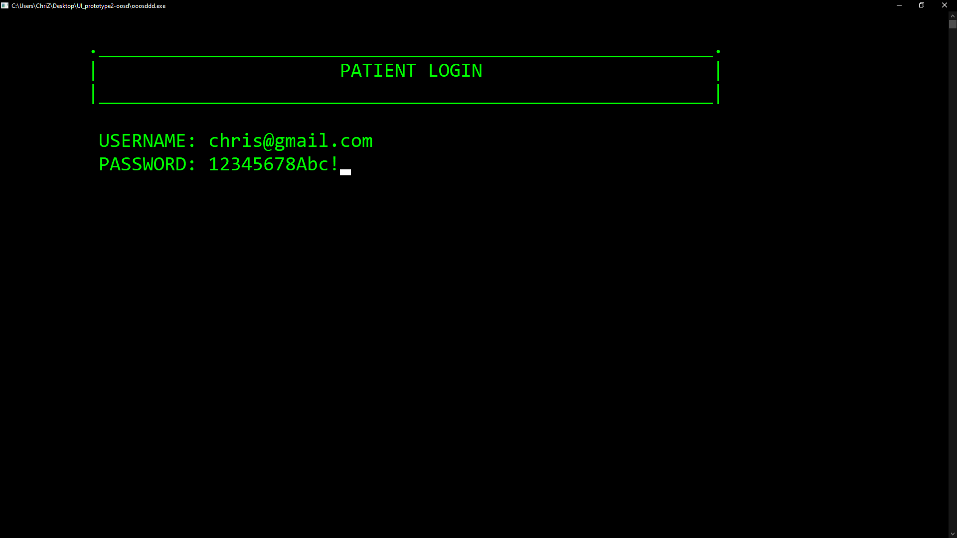
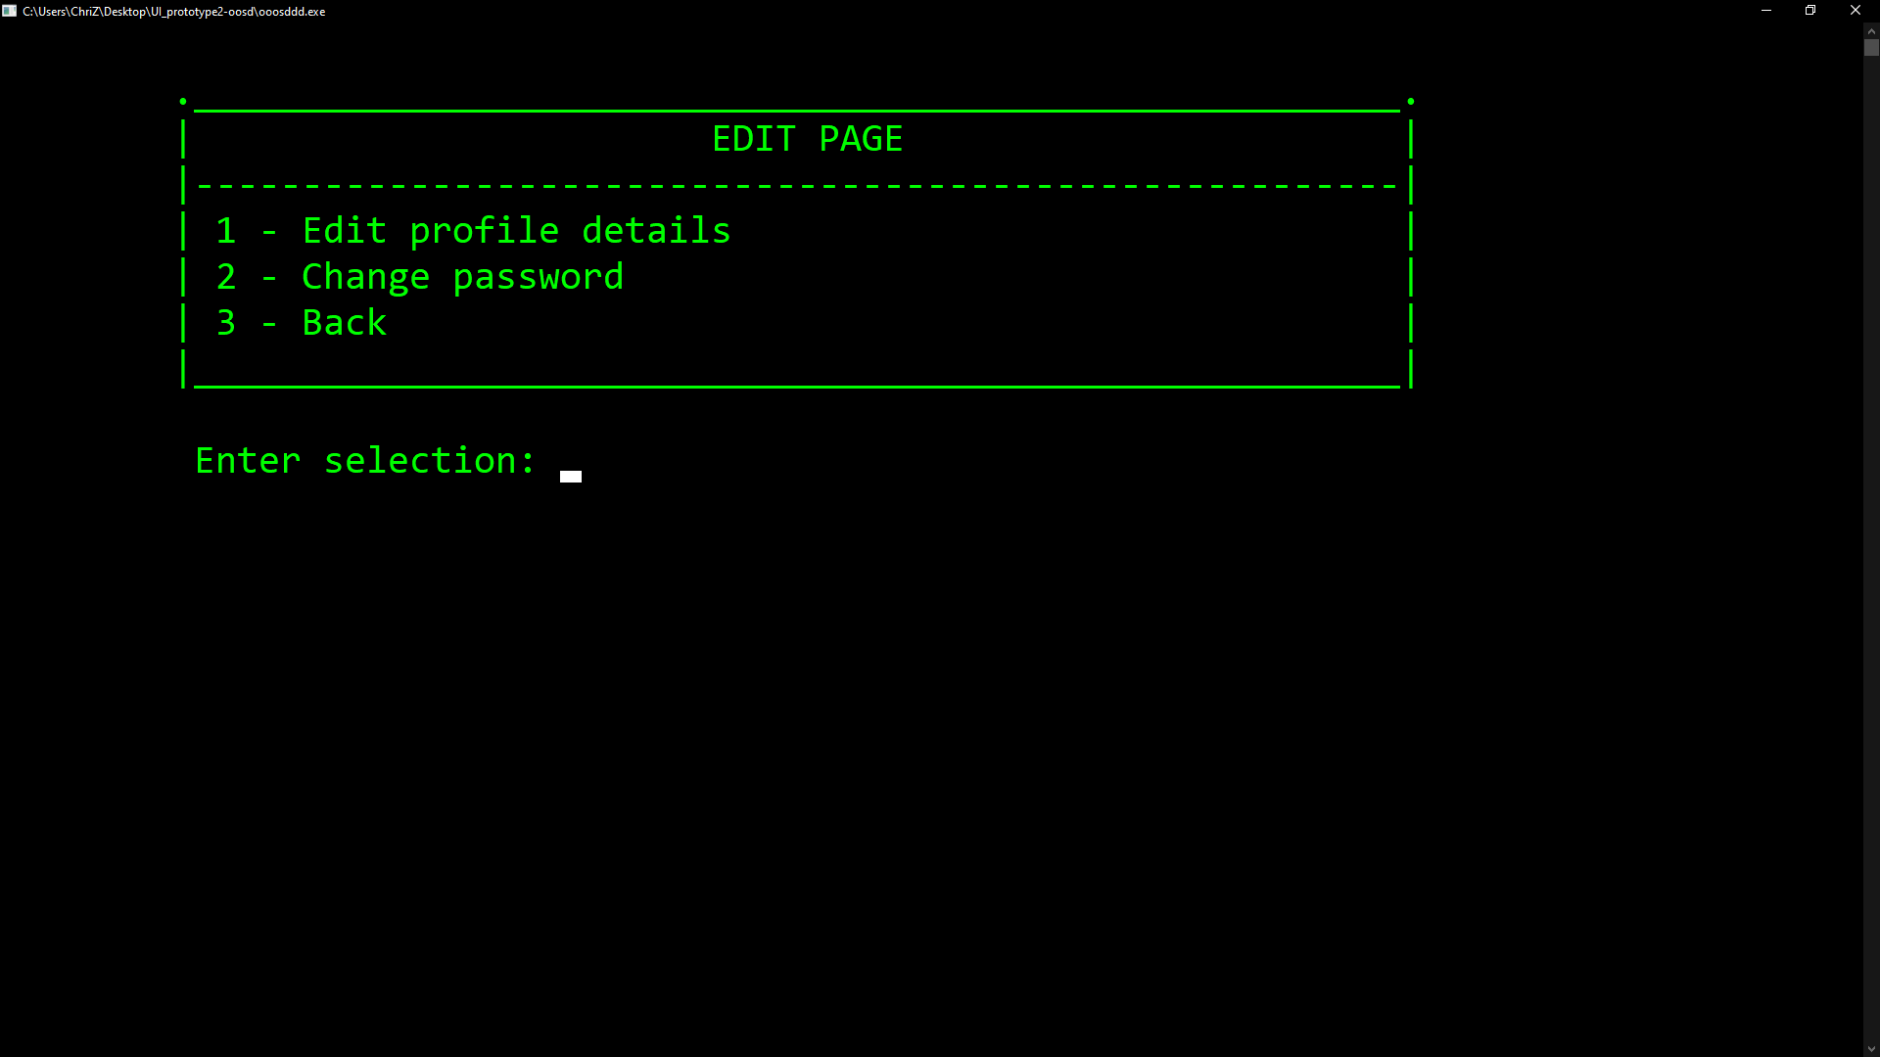
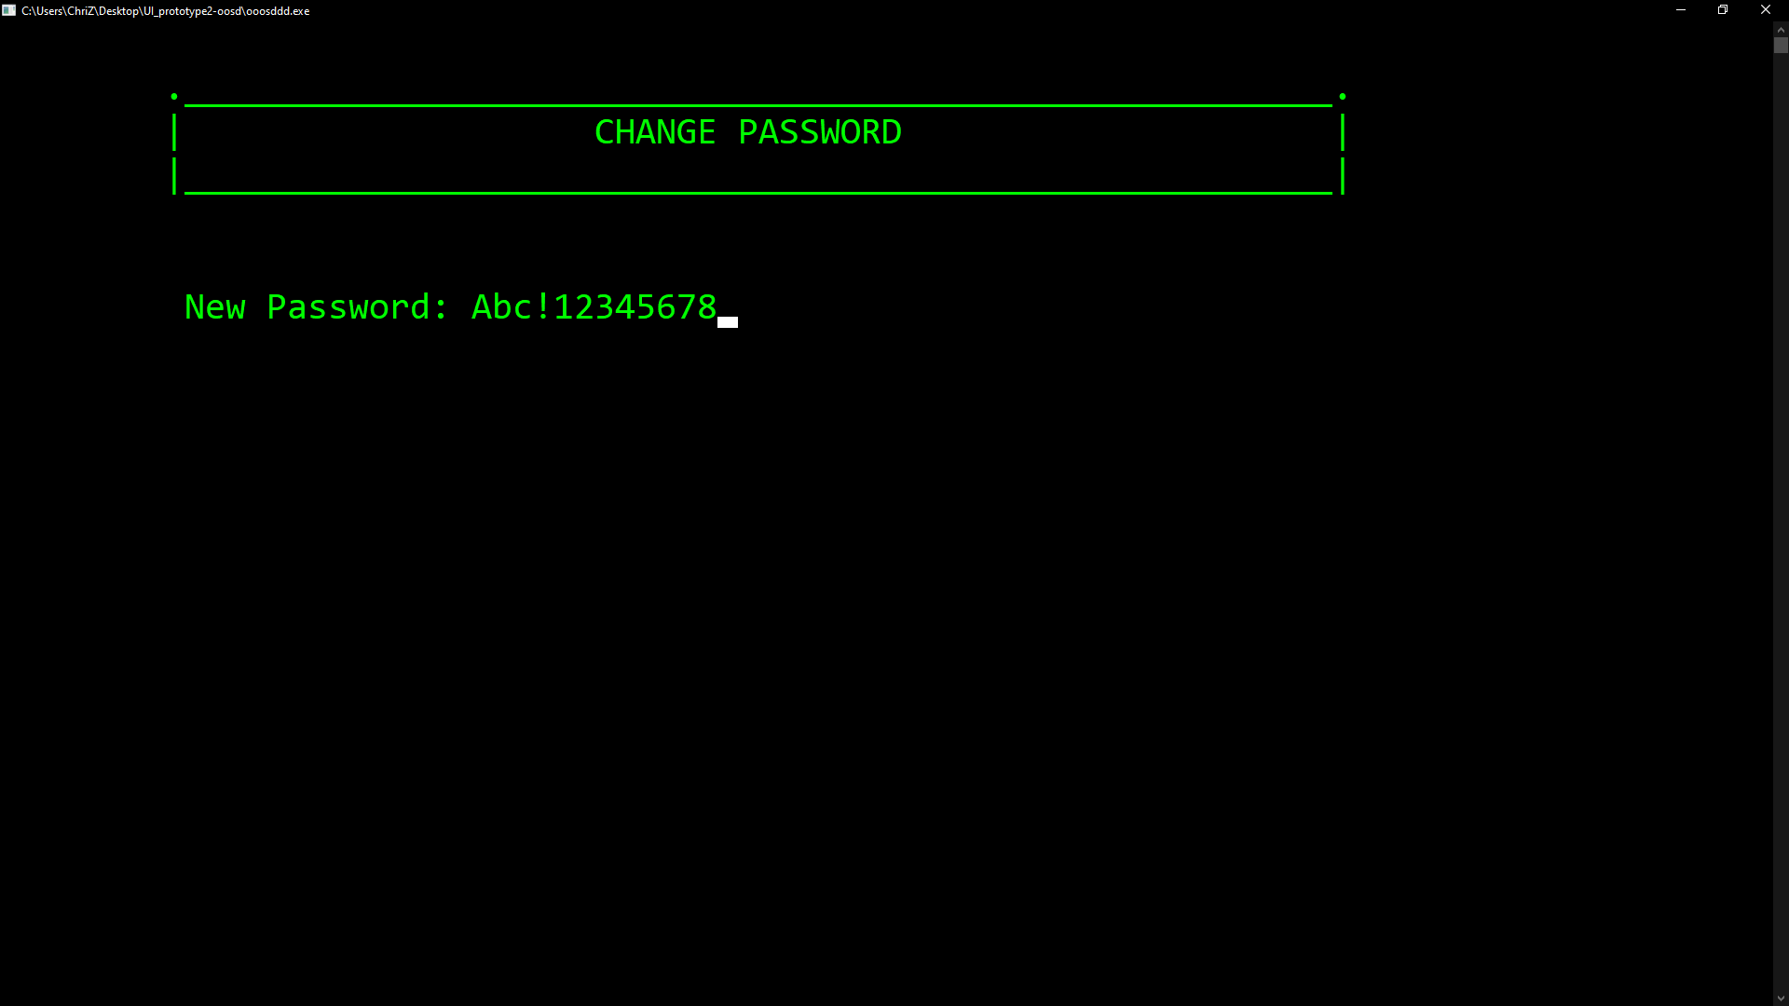
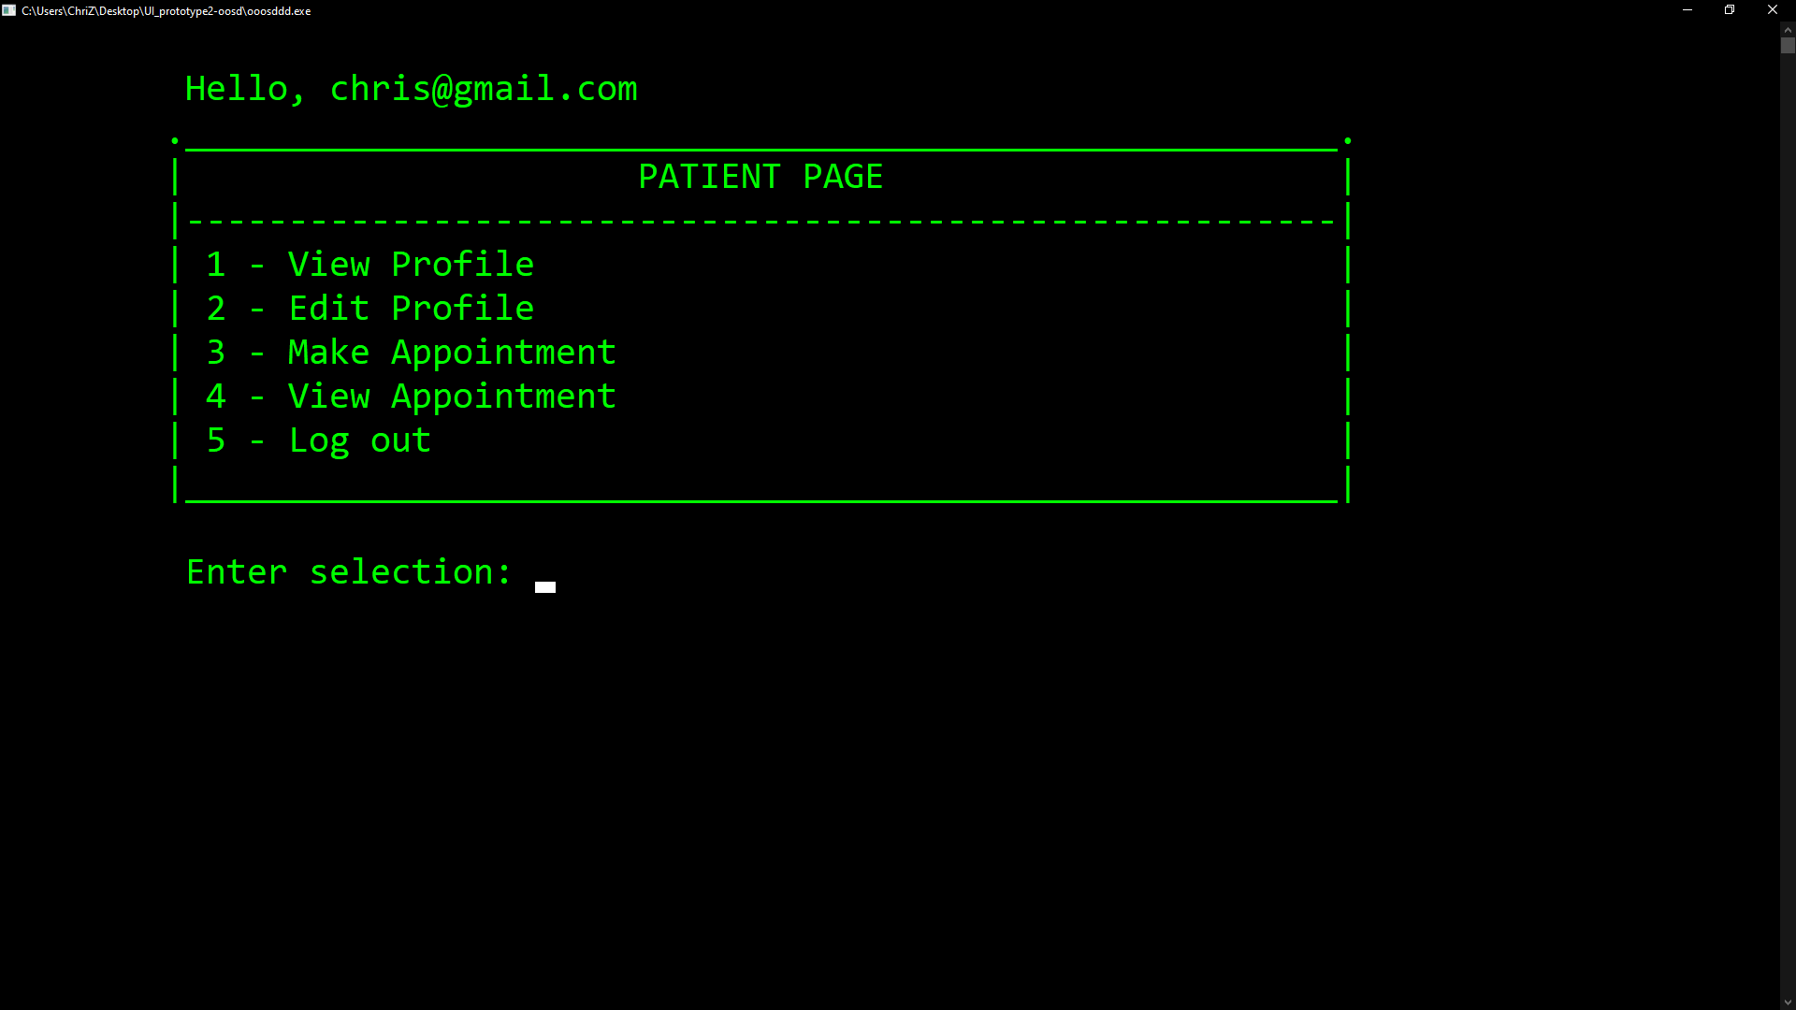
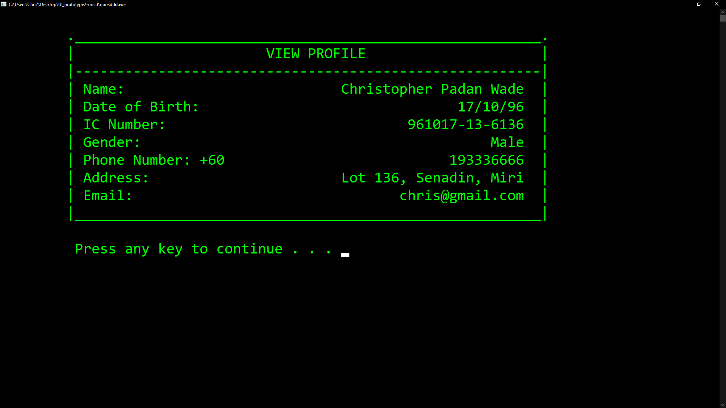
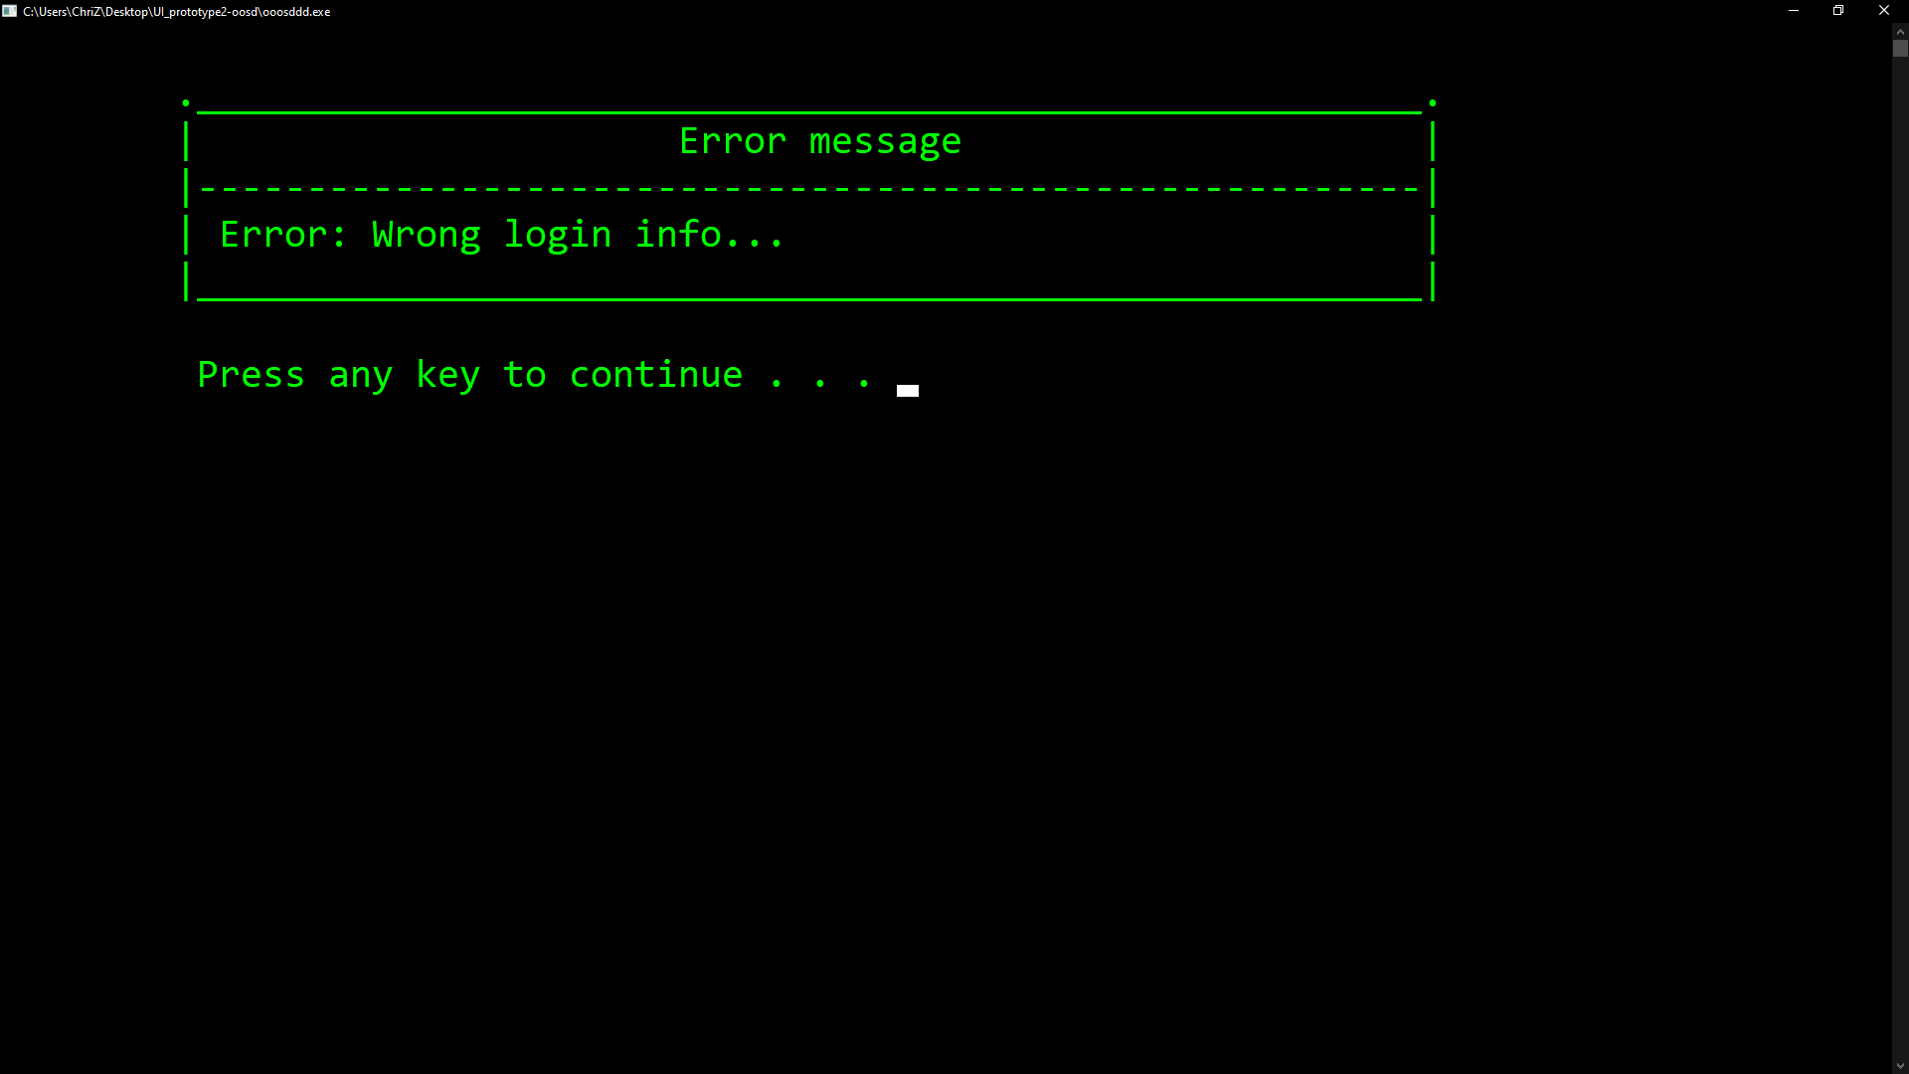
Patient

Slide 7
test case: Make appointment and payment
Test case 10 | Make appointment (positive)
Input value | Select day: 25 Select month: 12 Select slot: 6
Action | Select Patient option Log in with correct patient username and password Select Make Profile
Expected output | Appointment booked, proceeding to payment.
Test case 11 | Make appointment (negative)
Input value | Select day: 32 Select month: 13 Select slot: 16
Action | Select Patient option Log in with correct patient username and password Select Make Profile
Expected output | Wrong format!! Please enter again..
Test case 12 | Make Payment
Input value | Payment method (1 - Credit / 2 - Debit): 1 Cardholder: Christopher D Wade Card Number(include - ): 4983-1234-5678-9101 Valid till: 12/29 CVV/CVC: 393
Action | Select Patient option Log in with correct patient username and password Select Make Profile Key in valid appointment
Expected output | Payment success Appointment booking price: RM 50.50 Cardholder: Christopher D Wade Status: Paid Payment details sent to chris6055@gmail.com

Slide 8
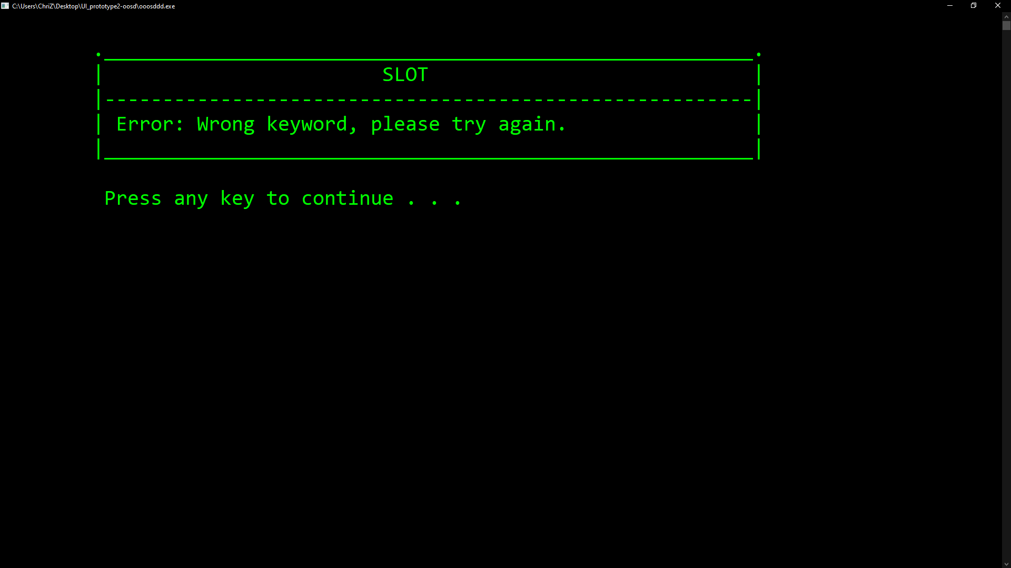
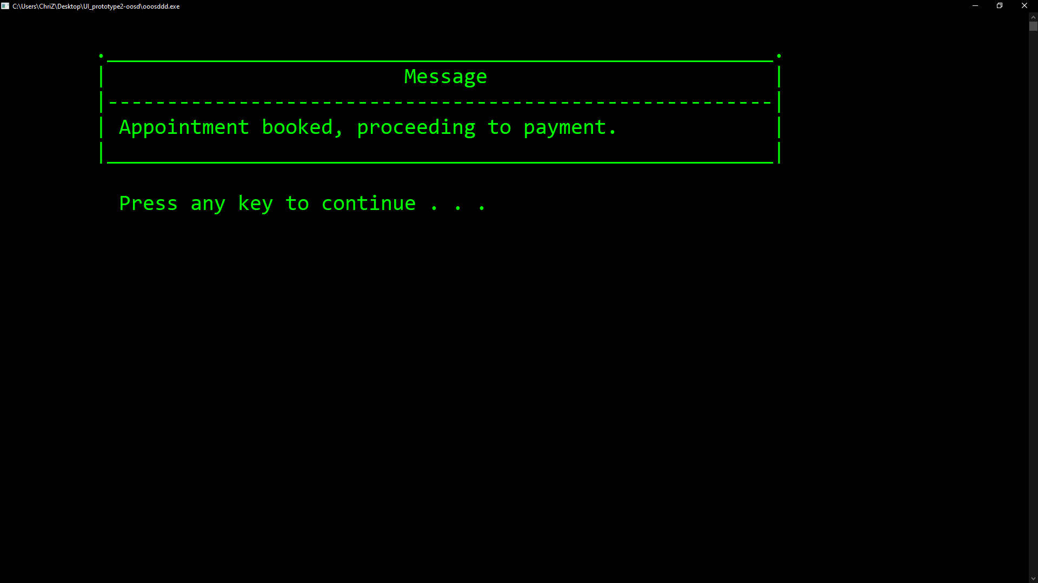
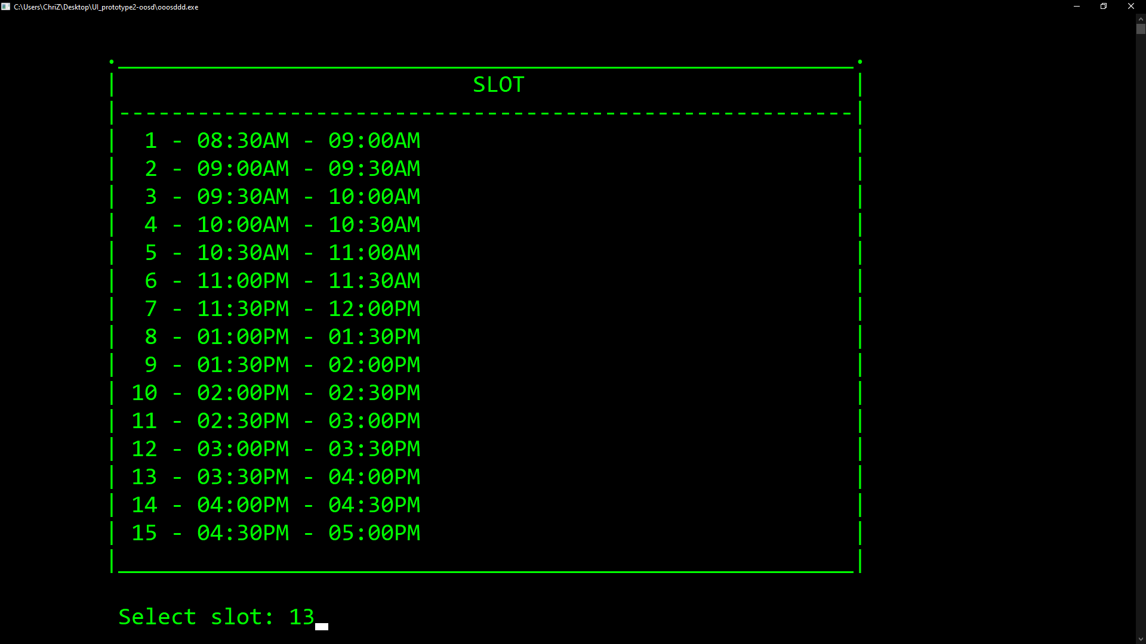
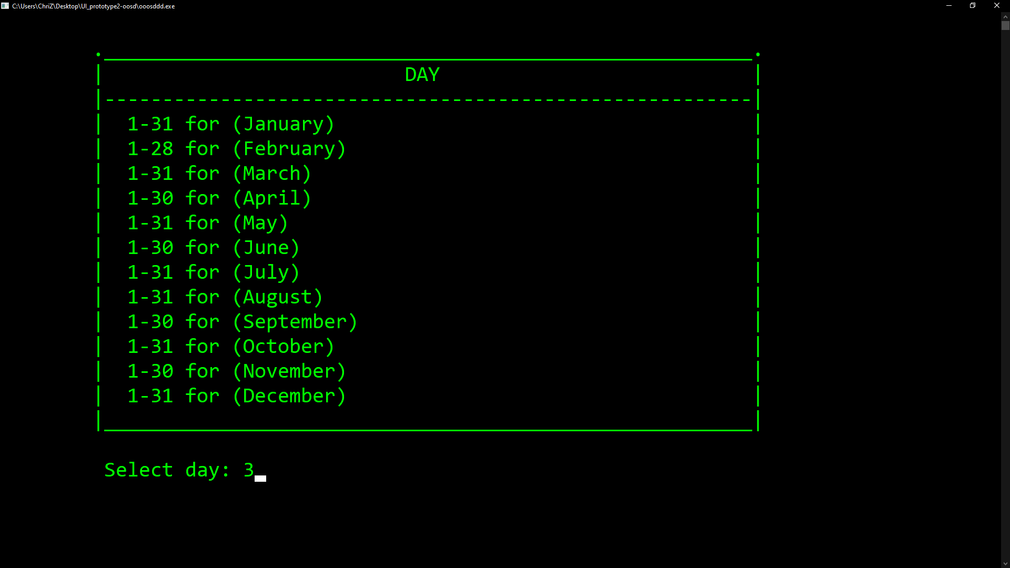
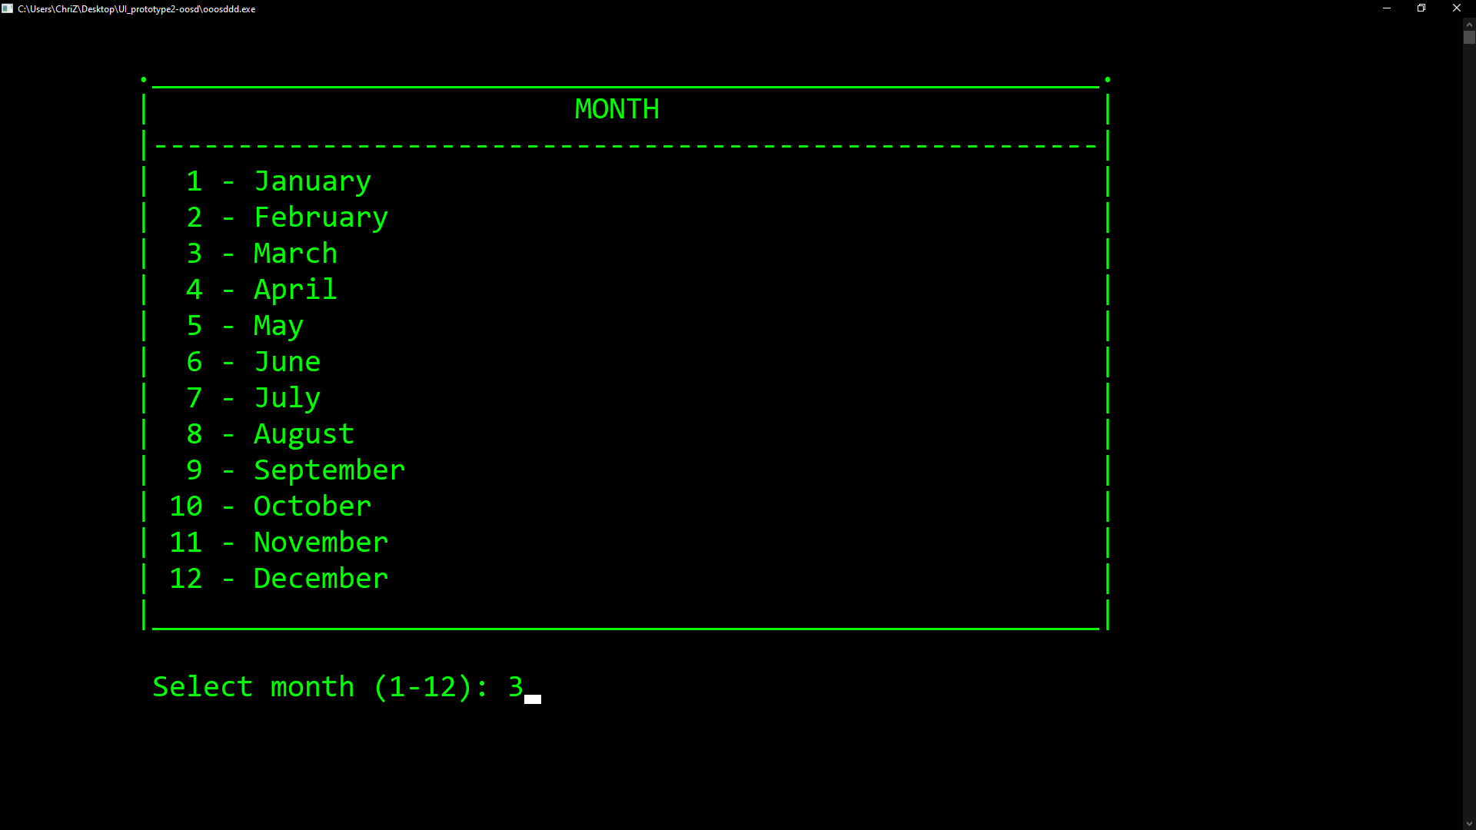
Make appointment

Slide 9
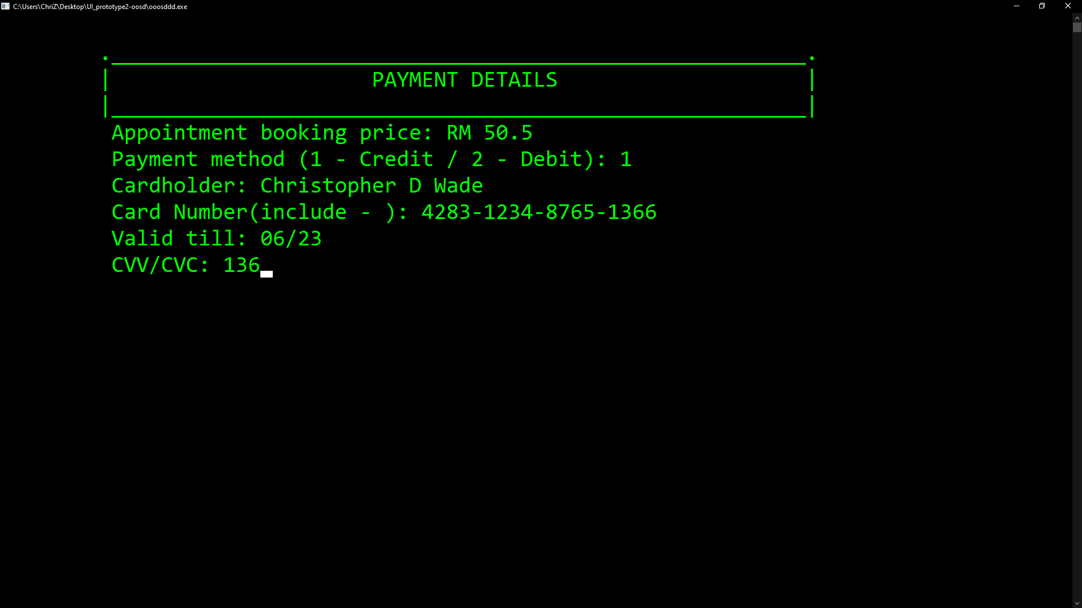
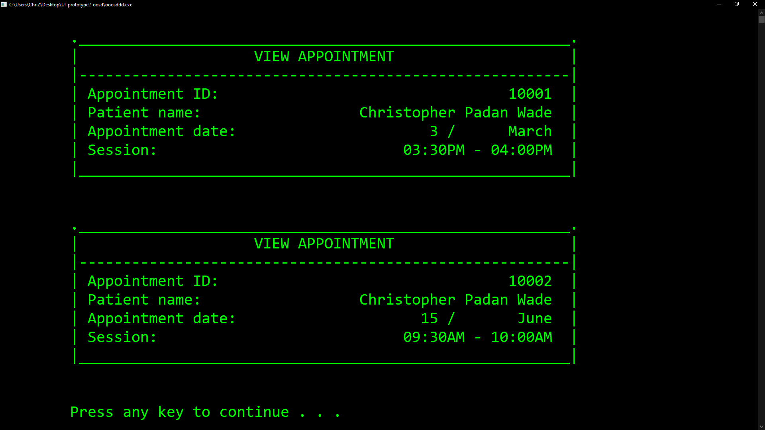
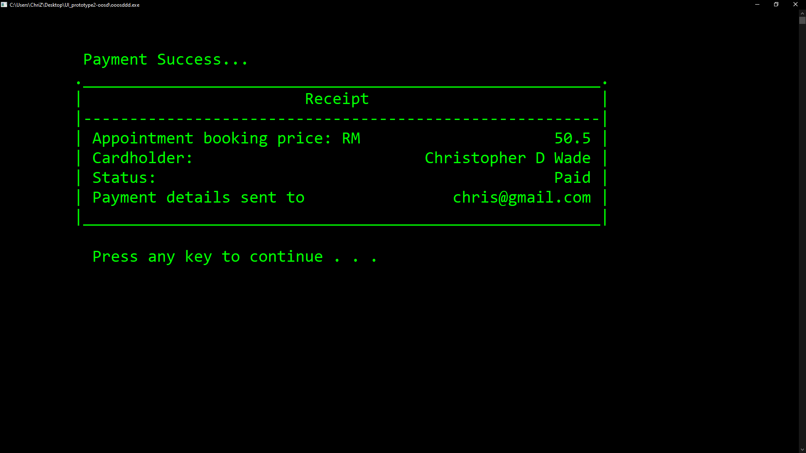
payment

Slide 10


